Slide 1
Module D-Functions
Modularity
Scope of a variable
Pointers
Module-D-Functions
<number>/41

Slide 2
Modularity
Structured Design
In-Class Practice
Functions
Prototypes
Style
Module-D-Functions
<number>/41

Slide 3
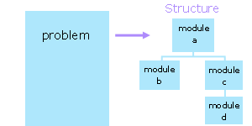
Structured Design
In designing a program, we subdivide the problem conceptually into a set of design units. We call these design units modules. In subdividing the problem, we reduce the number of factors with which to deal simultaneously.
Module-D-Functions
<number>/41

Slide 4
Module (1)
We select each module so that it
  is easy to upgrade,
  contains a readable amount of code, and
  can be used as part of the solution to some other proble
In designing a module, we
  select a descriptive identifier for the module,
  identify the tasks to be performed within the module.
Module-D-Functions
<number>/41

Slide 5
Module (2)
In a structured design
each module has one entry point and one exit point,
each module is highly cohesive (performs a single task ), and
each module exhibits low coupling.
Module-D-Functions
<number>/41

Slide 6
Cohesion
Cohesion is a measure of the focus within a module.
A module is highly cohesive if it performs a single task.
A module is low in cohesion if it performs a collection of unrelated tasks.
In designing a cohesive module, we ask whether a certain task belongs:
  The reason to include it is that it is related to the other tasks in some particular manner.
  A reason to exclude it is that it is unrelated to the other tasks.
Module-D-Functions
<number>/41

Slide 7
Coupling
Coupling is a measure of the degree of interrelatedness of a module to its referring module(s).
A module is low in coupling if it performs its tasks on its own.
A module is highly coupled if it shares that performance with some other module including the referring module.
In designing for low coupling, we ask what kind of data to avoid passing to the module.
Module-D-Functions
<number>/41

Slide 8
In-class practice
Design a program that either calculates the value of an integer raised to the power of an integer exponent or the arithmetic mean of a series of integers, depending upon a choice made by the user.
  list all of the tasks that the program should perform to solve this problem
  identify the modules for the problem structure
  check that each module is high in cohesion
  check that each module is low in coupling
Module-D-Functions
<number>/41

Slide 9
Functions
In C, we represent a module by a function.
A function may receive data and may return a value.
The description of the internal logic of a function as the function's definition
Module-D-Functions
<number>/41

Slide 10
Function Definition
A function definition consists of a header and a body.
The body is the code block that contains the module instructions and generates the return value.
The header, which precedes the body, includes the module name and the list of parameters that receive the module data enclosed within parentheses.
Module-D-Functions
<number>/41

Slide 11
syntax of a function definition
returnDataType functionIdentifier ( dataType parameterIdentifier, dataType parameterIdentifer, ... )
{
/* declarations here */
/* logical constructs here */
return /* return expression here */;
}
Module-D-Functions
<number>/41

Slide 12
Explain on functional syntax
returnDataType is the data type of the value returned by the function.
functionIdentifier is the name of the module.
The parameterIdentifiers between the parentheses are the names of the parameters.
The dataTypes are the data types of the parameters.
Module-D-Functions
<number>/41

Slide 13
void Functions
To identify a function that does not return any value, we specify void for the return data type and exclude any expression from the return statement:
Alternatively, we can omit the return statement altogether.
A function that does not return a value is called a subroutine or procedure in other languages.
Module-D-Functions
<number>/41

Slide 14
Calls
We use function calls to transfer execution control to functions. The syntax of a function call is
functionIdentifier(argument1,argument2,...);
Once a function finishes executing its own instructions, it returns control to the point immediately following the initiating call.
Module-D-Functions
<number>/41

Slide 15
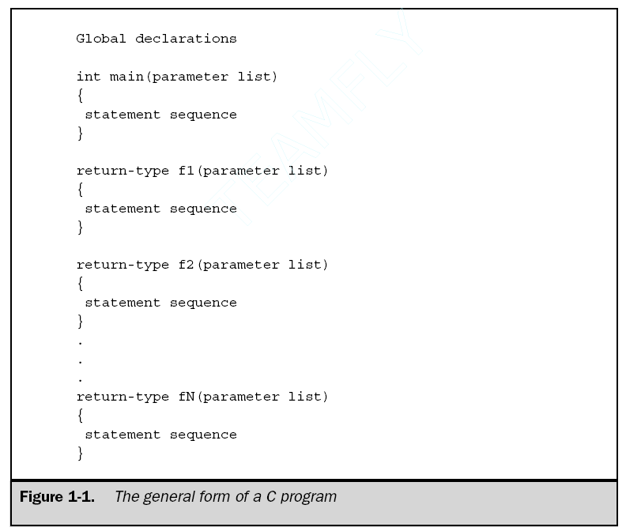
The general form of a C program
Module-D-Functions
<number>/41

Slide 16
Pass By Value (1)
The function receives copies of the data supplied by the arguments in the function call (the compiler allocates space for each parameter and initializes each parameter to the value of the corresponding argument in the function call)
So anything passed into a function call is unchanged in the caller's scope when the function returns.
What is the key difference between pass-by-value and pass-by-reference?
Pass-by-reference parameter lets the function knows the memory location of the parameter and therefore can directly modify the parameter.
Pass-by-value parameter just gives the function the value of the parameter and therefore any change to the parameter will not be preserved after the function returns.
Module-D-Functions
<number>/41

Slide 17
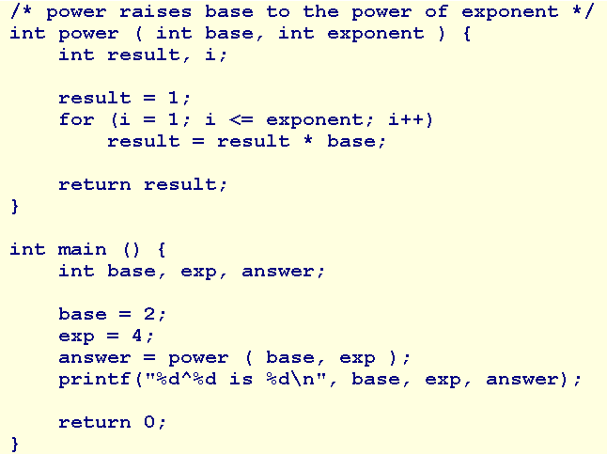
Pass By Value (2)
Module-D-Functions
<number>/41

Slide 18
main function
The main() function is the function to which the operating system transfers control at the start of execution.
main returns a value to the operating system upon completing execution. C compilers assume an int where we don't provide a return data type.
The operating system typically accepts a value of 0 as an indicator of success and may use this value to control subsequent execution of other programs. .
Module-D-Functions
<number>/41

Slide 19
Coercion
If there is a mismatch between the data type of an argument and the data type of the corresponding parameter, the compiler, wherever possible, coerces the value of the argument into the data type of the parameter.
Module-D-Functions
<number>/41

Slide 20
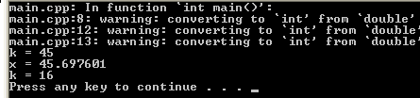
Coercion example
#include <stdio.h>
#include <math.h>
//=============
int main()
{int k1,k2,h;
k1 = pow(2.6, 4 );
printf("k = %d\n", k1);//45
float x = pow(2.6, 4 );
printf("x = %f\n", x);//45.697601
h = 2.6;
k2 = pow(h, 4 );
printf("k = %d\n", k2);//16
return 0;
}
Module-D-Functions
<number>/41

Slide 21
In-Class Practice
Code the function calls and headers for your design of the power/arithmetic-mean program.
Module-D-Functions
<number>/41

Slide 22
Prototypes
Function prototypes describe the form of a function without specifying the implementation details.
To validate the number of arguments, the compiler needs to know the number of parameters.
To coerce argument values, the compiler needs to know the data types of the parameters.
To determine the data type of the call expression, the compiler needs to know the return data type of the function.
A function prototype provides these three pieces of information.
Module-D-Functions
<number>/41

Slide 23
syntax of a prototype
  returnDataType functionIdentifier ( dataType [parameterIdentifier], dataType [parameterIdentifier], ... );
A function prototype ends in a semi-colon and has no function body.
The parameter identifiers are optional.
We place function prototypes near the head of our source file and before any function definitions.
For Example: int power (int, int);
Module-D-Functions
<number>/41

Slide 24
#include
We can collect function prototypes into file (along with any #define directives) and refer to the file in our program. Such a file is called a header file.
We use the #include directive to instruct the compiler to insert a copy of the header file into our source code.
Syntax:
  #include "filename" //in current directory
  #include <filename> // in system directories
Module-D-Functions
<number>/41

Slide 25
Style
For style, we
  declare a prototype for each function definition
  specify the return data type in each function definition
  specify void for a function with no parameters
  avoid calling the main function recursively
  include parameter identifiers in the prototype declarations
  use generic comments and variables names so that we can use the function in a variety of applications without modifying its code
Module-D-Functions
<number>/41

Slide 26
Summary
Modularity
Structured Design
In-Class Practice
Functions
Prototypes
Style
Q&A
Module-D-Functions
<number>/41

Slide 27
Scope of a Variable
Local or Global Variables
Basic Validation
Visibility
Walkthroughs with Functions
In-Class Practice
Module-D-Functions
<number>/41

Slide 28
Extent and Scope
The status of any variable in a program is described by two aspects: its extent and its scope.
Its extent is that part of the program over which the variable has memory allocated for it; that is, the lifetime or storage duration of the variable.
The scope of a variable is that part of a program over which the variable is visible; that is, the part over which expressions can access the variable.
The extent of a variable sets the limits on its scope. Variables that are defined within any function are limited in scope to the function within which they are defined. They are invisible outside the function.
Module-D-Functions
Module-D2-Scope of a variable
<number>/41

Slide 29
Local or Global
A variable that is defined within either a function or code block is a local variable.
A variable that is declared outside any function including main is a global variable. The compiler allocates memory for global variables separately and that memory cannot be shared with any other variable. Global variables introduce a high degree of coupling, avoid using global variables altogether .
Module-D-Functions
Module-D2-Scope of a variable
<number>/41

Slide 30
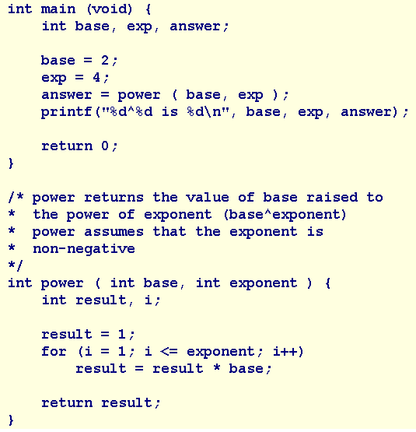
Basic Validation
Let us elaborate our design to accomodate input of the integer values from the user.
what happens?
Let us also add a supporting function that discards any unwanted input.
Module-D-Functions
<number>/41

Slide 31
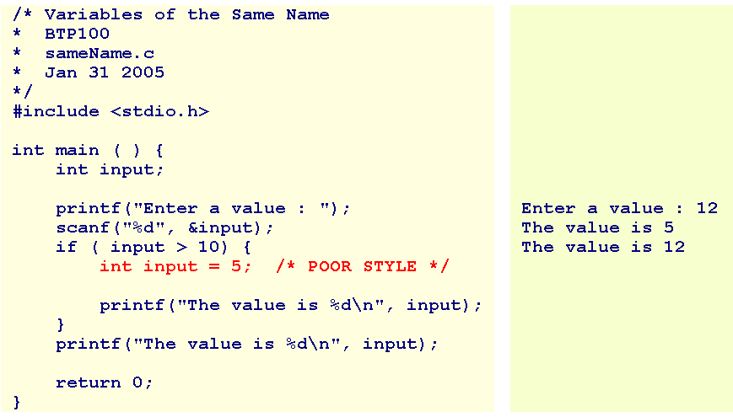
Visibility
A local variable is visible from its declaration to the end of the code block within which that variable was declared.
Module-D-Functions
<number>/41

Slide 32
Summary
Scope of a Variable
Local or Global Variables
Basic Validation
Visibility
Walkthroughs with Functions (read at home)
Practice (home work)
Q&A
Module-D-Functions
<number>/41

Slide 33
Pointers
Explain what a pointer is and where it is used
Explain how to use pointer variables and pointer operators
Assign values to pointers
Explain pointer arithmetic
Explain pointer comparisons
Module-D-Functions
<number>/41

Slide 34
What is a Pointer?
A pointer is a variable, which contains the address of a memory location of another variable
If one variable contains the address of another variable, the first variable is said to point to the second variable
A pointer provides an indirect method of accessing the value of a data item
Pointers can point to variables of other fundamental data types like int, char, or double or data aggregates like arrays or structures
Module-D-Functions
<number>/41

Slide 35
What are Pointers used for?
Some situations where pointers can be used are:
To return more than one value from a function
To pass arrays and strings more conveniently from one function to another
To manipulate arrays easily by moving pointers to them
instead of moving the arrays itself
To allocate memory and access it
(Direct Memory Allocation)
Module-D-Functions
<number>/41

Slide 36
Pointer Variables
A pointer declaration consists of a base type and a variable name preceded by an *
General declaration syntax is :
type *name;
For Example:
int *var2;
Module-D-Functions
<number>/41

Slide 37
Pointer Operators
There are 2 special operators which are used with pointers
&
and
*
The & operator is a unary operator and it returns the memory address of the operand
var2 = &var1;
The second operator * is the complement of &. It is a unary operator and returns the value contained in the memory location pointed to by the pointer variable’s value
temp = *var2;
Module-D-Functions
<number>/41

Slide 38
Assigning Values To Pointers-1
Values can be assigned to pointers through the & operator.
ptr_var = &var;
Here the address of var is stored in the variable ptr_var
It is also possible to assign values to pointers through another pointer variable pointing to a data item of the same data type
ptr_var = &var;
ptr_var2 = ptr_var;
Module-D-Functions
<number>/41

Slide 39
Assigning Values To Pointers-2
Variables can be assigned values through their pointers as well
*ptr_var = 10;
The above declaration will assign 10 to the variable var if ptr_var points to var
Module-D-Functions
<number>/41

Slide 40

Pointer Arithmetic (1)
Addition and subtraction are the only operations that can be performed on pointers
Let us assume that var is stored at the address 1000
Then ptr_var has the value 1000 stored in it. Since integers are 2 bytes long, after the expression “ptr_var++;” ptr_var will have the value as 1002 and not 1001
Module-D-Functions
<number>/41

Slide 41
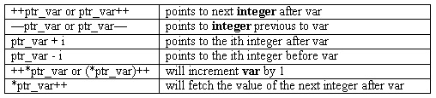
Pointer Arithmetic (2)
Each time a pointer is incremented, it points to the memory location of the next element of its base type
Each time it is decremented it points to the location of the previous element
All other pointers will increase or decrease depending on the length of the data type they are pointing to
Module-D-Functions
<number>/41

Slide 42
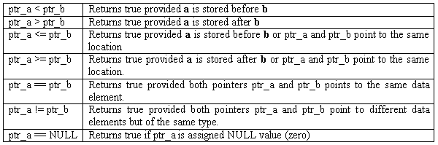
Pointer Comparisons
Two pointers can be compared in a relational expression provided both the pointers are pointing to variables of the same type
Consider that ptr_a and ptr_b are 2 pointer variables, which point to data elements a and b. In this case the following comparisons are possible:
Module-D-Functions
<number>/41

Slide 43
Summary
Pointer
Explain what a pointer is and where it is used
Explain how to use pointer variables and pointer operators
Assign values to pointers
Explain pointer arithmetic
Explain pointer comparisons
Q&A
Module-D-Functions
<number>/41

